Slide 1
HEALTHCARE DATA ANALYSIS & VISUALIZATION
Defense Presentation
Presented by: Safiriyu Mariam

Slide 2
Introduction & Background
Healthcare data
Large volumes
Patient and operational data are generated continuously across healthcare activities.
Why analysis?
Find patterns
Analysis helps reveal patterns that may be difficult to identify from raw data alone.
Why visualization?
Communicate insights
Visuals make complex information easier to understand and communicate.
• This project transforms healthcare data into meaningful insights using analytics and visualization.
• The analysis focuses on patient demographics, medical conditions, billing, length of stay and admission patterns.
2

Slide 3
Problem Statement
Challenge 1
Difficulty identifying patient demographic patterns.
Challenge 2
Limited visibility into the distribution of medical conditions.
Challenge 3
Difficulty monitoring hospital billing patterns.
Challenge 4
Lack of clear insight into patient length of stay.
Challenge 5
Difficulty identifying trends in hospital admissions.
.
3

Slide 4
Aim & Objectives
AIM
To analyse healthcare data and develop an interactive Power BI dashboard for generating meaningful insights into patient demographics, medical conditions, billing and hospital stay patterns.
OBJECTIVES
1. Analyse patient demographics
2. Examine medical conditions
3. Analyse patient age groups
4. Examine length of hospital stay
5. Analyse billing amounts
6. Identify admission patterns
7. Develop an interactive Power BI dashboard
4

Slide 5
Dataset, Source & Tools
Dataset
Healthcare Patient Dataset
Microsoft Excel
Initial data inspection and preparation
Power Query
Data cleaning and transformation
Source
Kaggle – Healthcare Dataset
Power BI
Data modelling, analysis and visualization
DAX
Measures and calculations
5

Slide 6
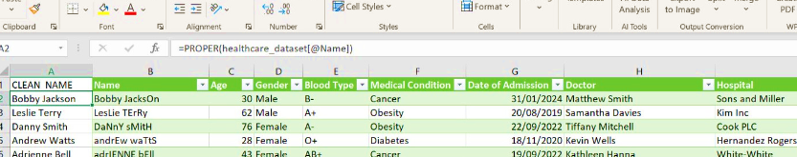
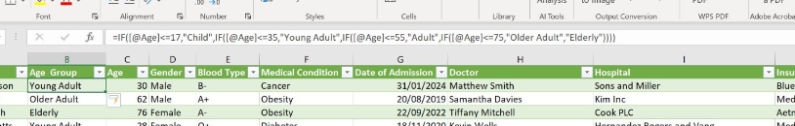
Data Cleaning & Transformation
• Reviewed and handled inconsistencies and missing or inconsistent values.
• Standardized patient names using proper case.
• Created age-group categories for demographic analysis.
• Calculated length of stay from the date fields.
• Extracted admission month for trend analysis.
• Checked date fields and prepared the dataset for analysis.
6

Slide 7
Data Model & DAX Measures
Excel
Initial inspection
Power Query
Clean & transform
Power BI
Model & visualize
DAX
Calculate measures
DAX
Data Analysis Expressions
Formula language used in Power BI to create calculated measures and columns.
Measures used in this project
Total Patients
Average Age
Total Billing Amount
Average Billing Amount
Average Length of Stay
.
7

Slide 8
Key Performance Indicators
Total Patients
55,500 (≈56K)
Average Age
51.54 years
Total Billing
1.42 billion
Average Billing
25.54K
Average Length of Stay
15.51
Hospital KPI shown
40K
8

Slide 9
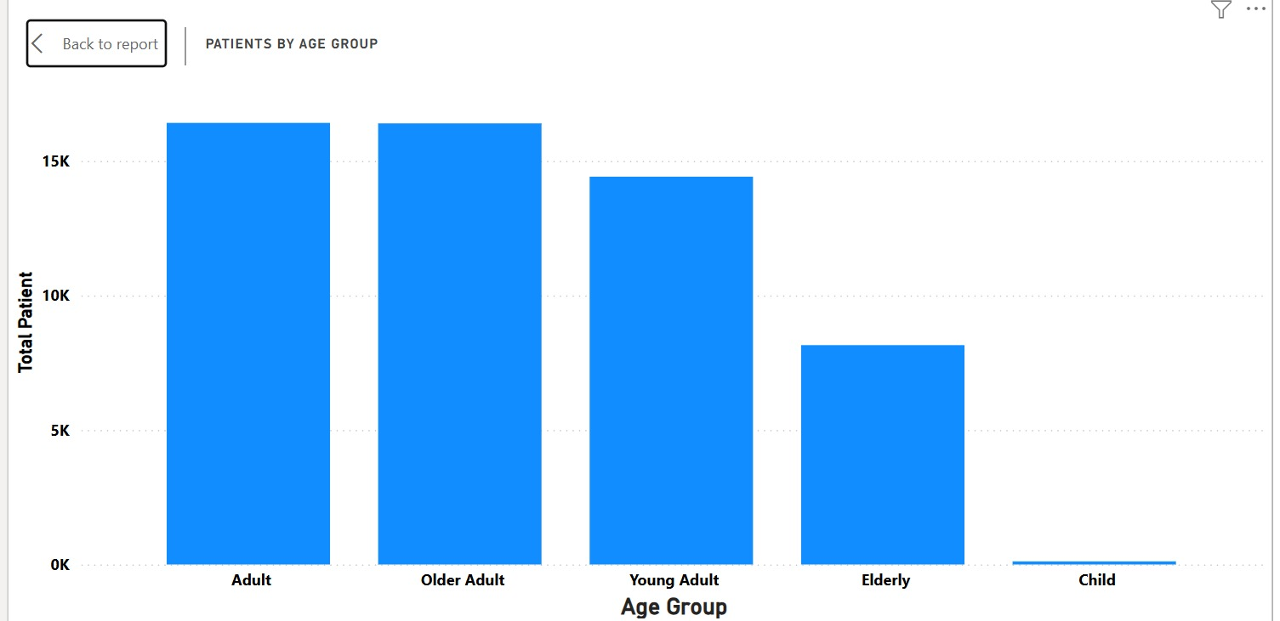
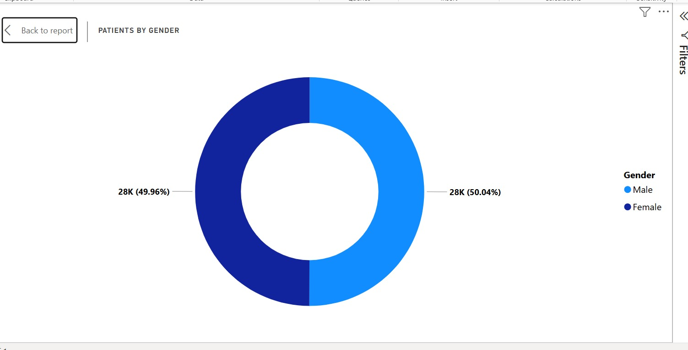
Patient Demographic Analysis
Key finding
Adults and older adults form the larger age-group categories shown.
Gender
Male 50.04% | Female 49.96% nearly equal.
9

Slide 10
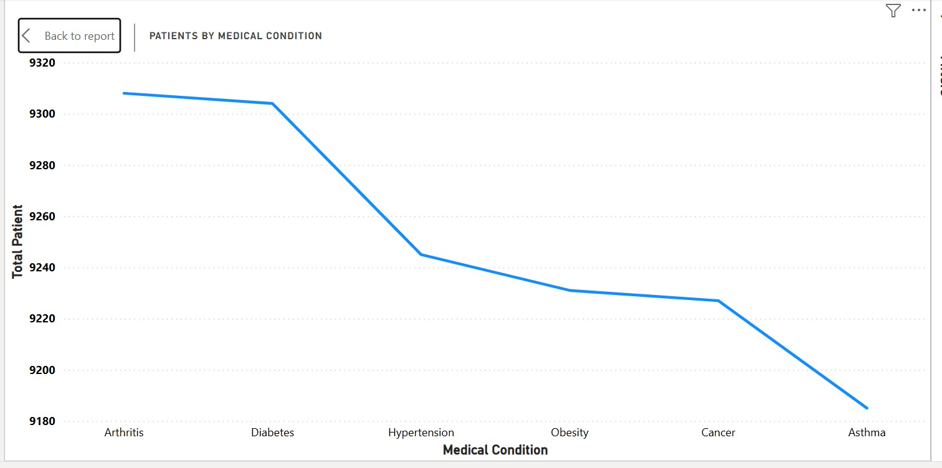
Medical Condition Analysis
Patient counts
Counts across the displayed conditions are relatively close.
Higher-count conditions
Arthritis and Diabetes are among the higher counts shown.
Lower-count condition
Asthma is the lowest among the conditions shown in this chart.
10

Slide 11
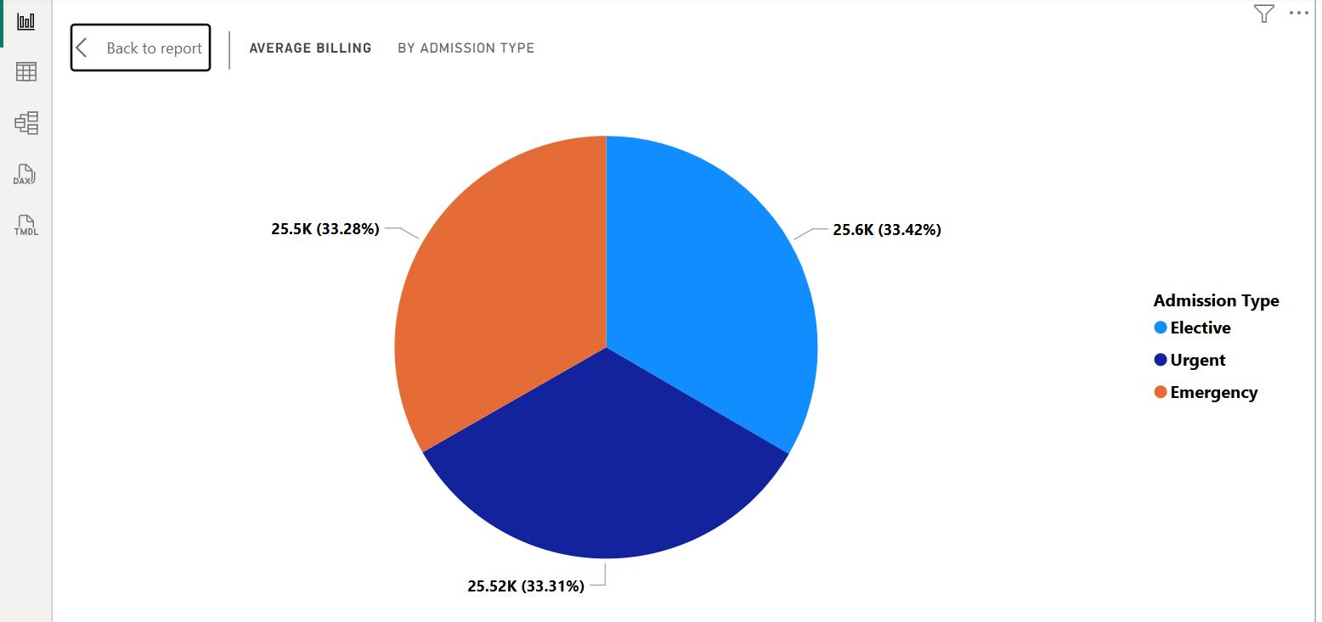
Billing Analysis
Average billing by admission type
Elective, Urgent and Emergency admissions are very similar, each around one-third of the displayed distribution.
11

Slide 12
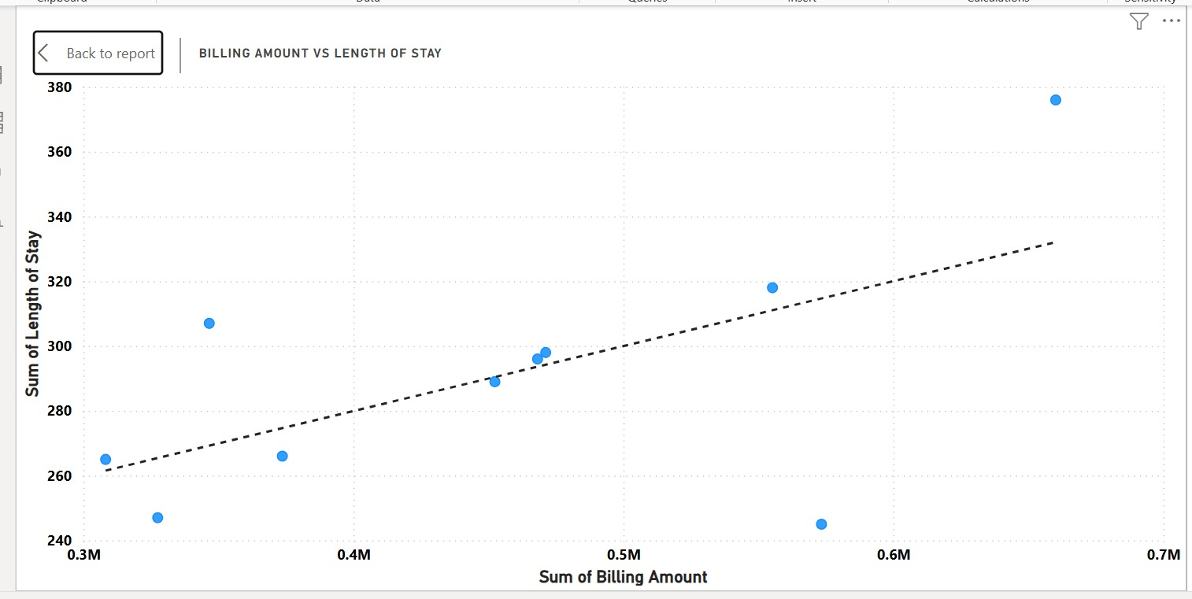
Billing Amount vs Length of Stay
Observed pattern
The trendline slopes upward, indicating a positive relationship in the aggregated data shown.
Interpretation
Higher billing amounts tend to occur alongside higher lengths of stay in the displayed data.
Not Every Case Follows the Trend:
Some data points fall significantly above or below the trend line, showing that other factors may also influence billing costs and length of stay.
Possible Factors to Explore Further: These variations could be influenced by factors such as:
Medical condition* Type of treatment* Hospital charges*
Patient demographics
* Severity of illness
12

Slide 13
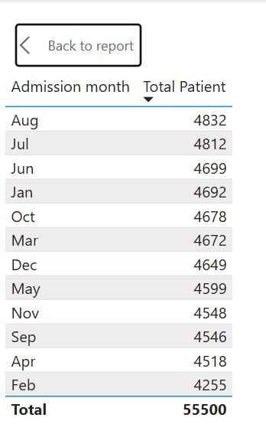
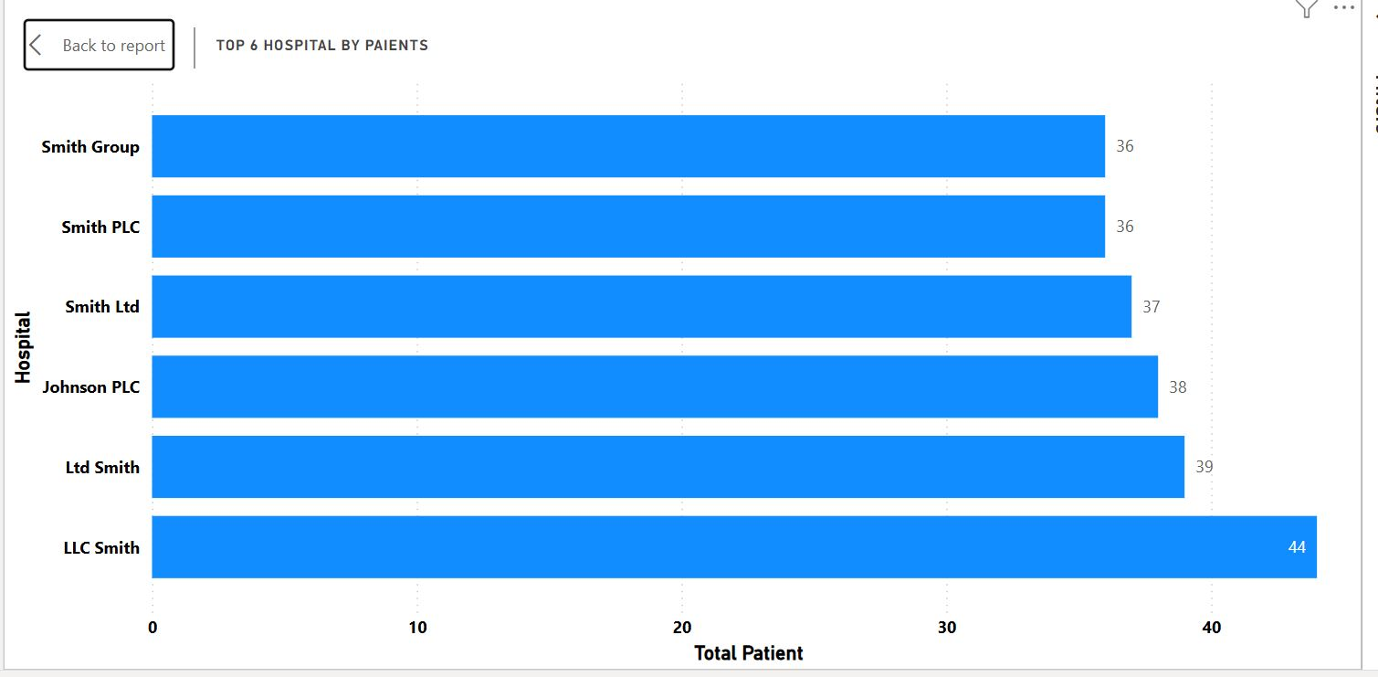
Admission Trends & Top Hospitals
Admission month
August — 4,832 (highest shown)July — 4,812\June — 4,699\January — 4,692\October — 4,678\March — 4,672\December — 4,649\May — 4,599\November — 4,548\September — 4,546\April — 4,518\February — 4,255 (lowest shown)
Top 6 hospitals by patients shown
LLC Smith — 44\Ltd Smith — 39\Johnson PLC — 38\Smith Ltd — 37\Smith PLC — 36\Smith Group — 36
13

Slide 14
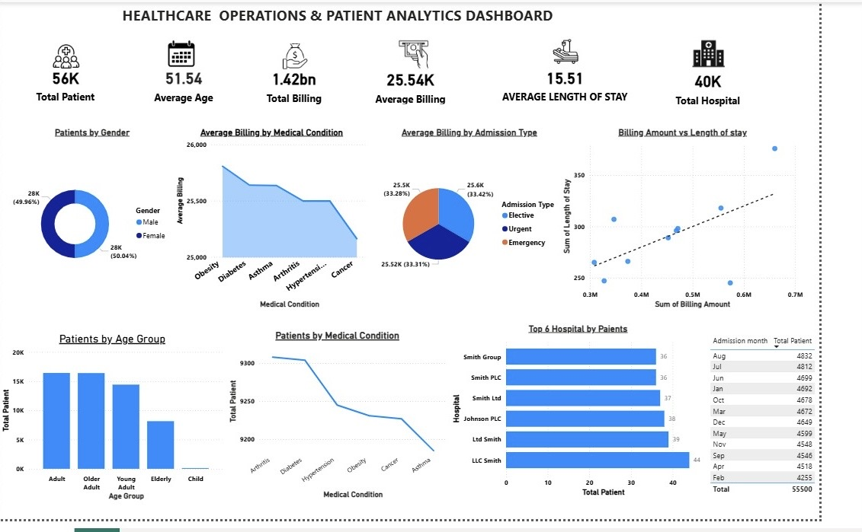
Interactive Power BI Dashboard
14

Slide 15
Key Insights
Patient volume
55,500 patients are represented in the dataset; the KPI displays this as approximately 56K.
Demographics
Average age is 51.54 years and gender distribution is almost evenly split.
Medical conditions
Patient counts across the displayed conditions are relatively similar.
Billing
Total billing is 1.42 billion and average billing is 25.54K.
Length of stay
Average length of stay is 15.51.
Admissions
August has the highest displayed admissions (4,832); February has the lowest (4,255).
Relationship
Billing amount and length of stay show a positive trend in the displayed aggregated data.
15

Slide 16
Recommendations
RECOMMENDATIONS
1. Use demographic and condition patterns to support resource planning.
2. Use admission trends to support staffing and capacity planning.
3. Monitor billing and length-of-stay patterns for operational and financial insight.
4. Continue using interactive dashboards to communicate healthcare information.
16

Slide 17
Conclusion
Conclusion
This project demonstrates how healthcare data can be transformed into meaningful insights through data cleaning, transformation, DAX calculations, visualization and dashboard development.
Project outcome
The resulting Power BI dashboard provides an interactive view of patient demographics, medical conditions, billing, length of stay and admission trends.
THANK YOU — QUESTIONS?
17

